Slide 1
Publish and Read
The author’s journey for fee-free open access

Slide 2
What to expect
Default OA under a Publish and Read agreement is administratively simple for authors with a light-touch through manuscript processing. All authors benefit from:
Unlimited OA Publishing in the Society’s six journals
Unlimited access to all content on our publishing platform www.microbiologyresearch.org

Slide 3
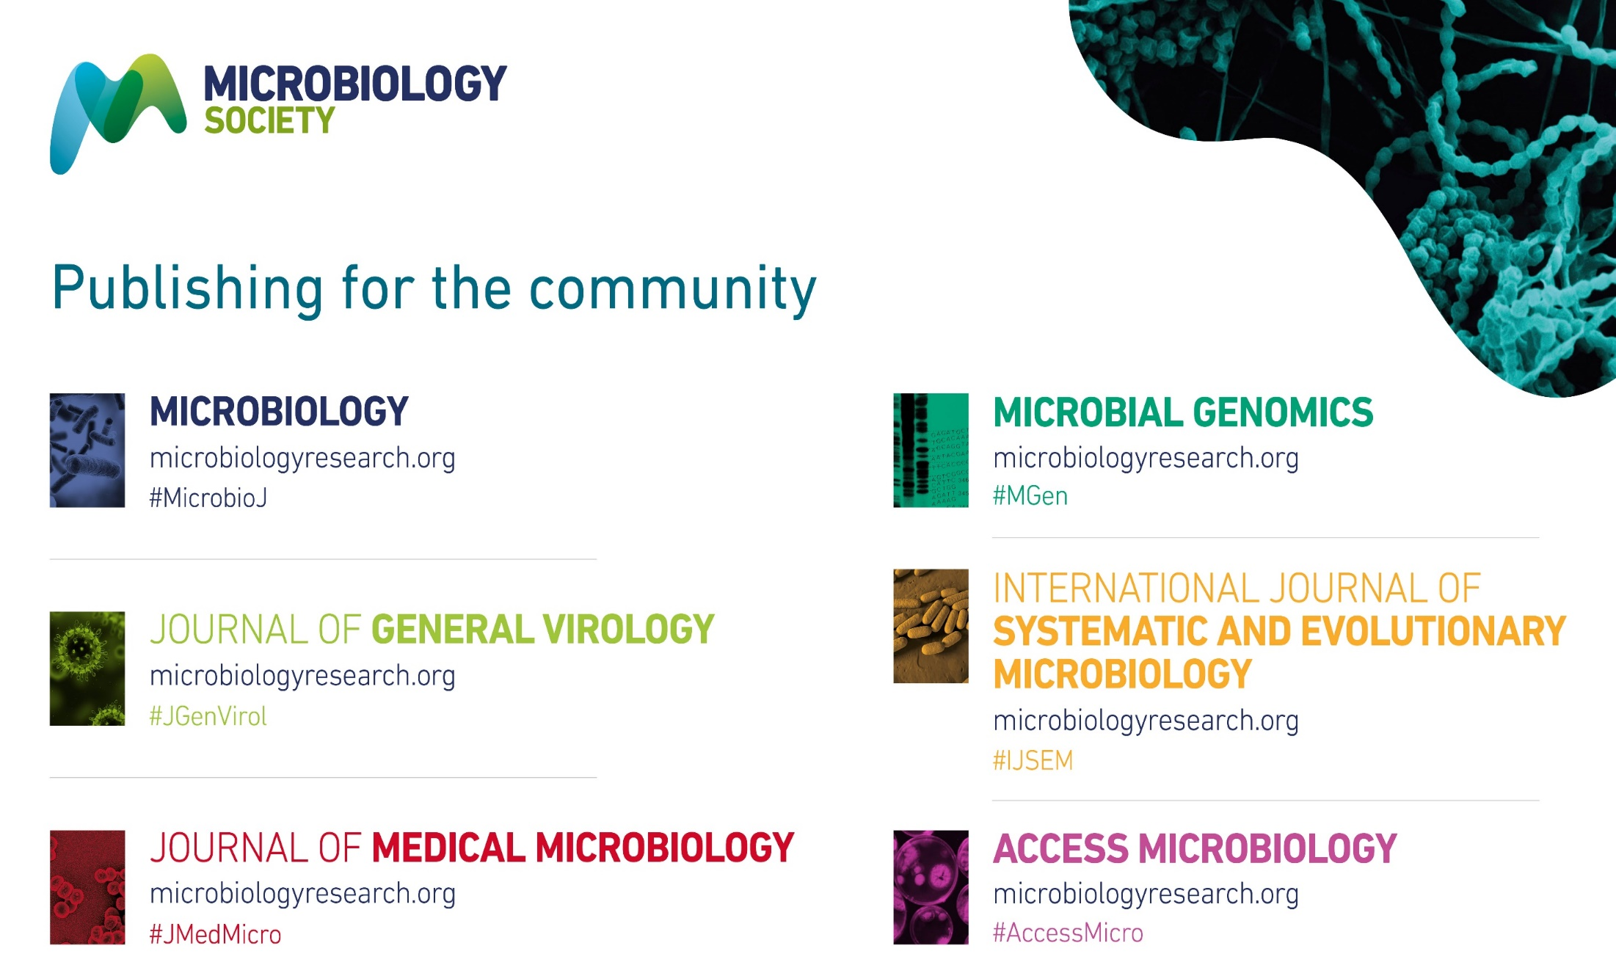
Eligible journals

Slide 4
The Author Journey
Manuscript Processing
Share article
Use eligibility criteria
Opt for the correct OA route
Sign Creative Commons licence
Check impact
Published article

Slide 5
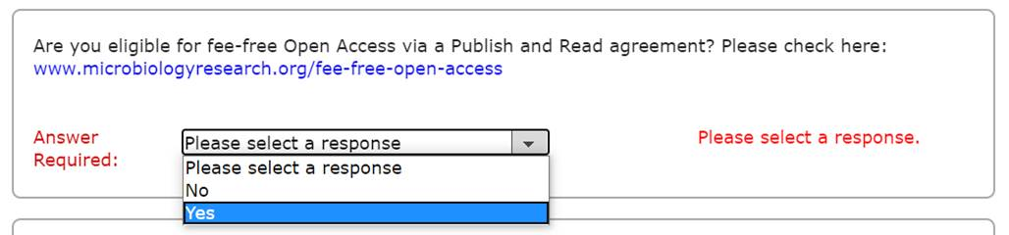
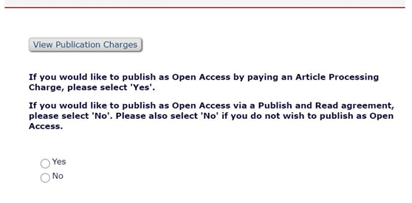
Manuscript Submission
Editorial Manager Screenshots
Article submission is a straightforward process using our peer review system.
Before you get started, you need to know that
The corresponding author must use a recognised institutional email address to be identified as eligible for Publish and Read. A subdomain can also be used, e.g. @(xxx)csic.es.
There are two potential OA routes: the APC-free route you take requires answering ‘No’ to the question here.
You will need to sign a Creative Commons licence when prompted to submit your revised manuscript

Slide 6
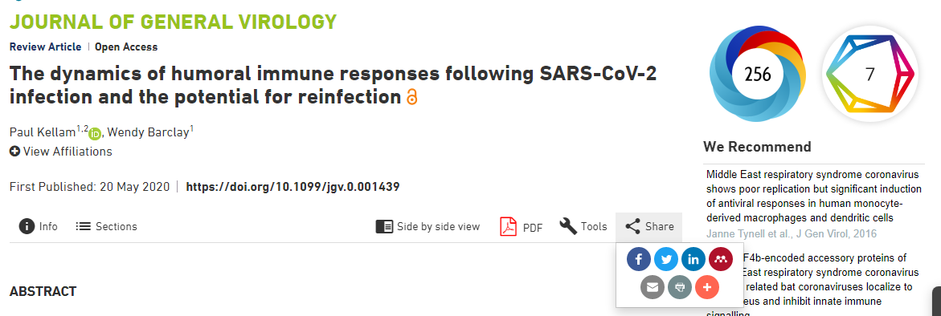
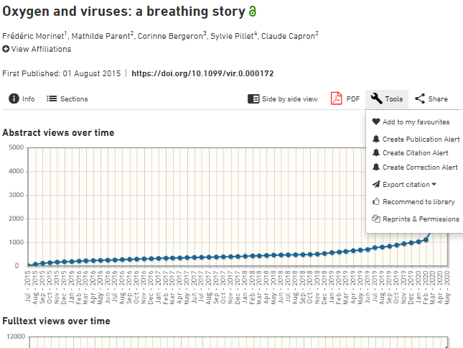
Published article
Congratulations!
You will receive notification when your article is published online on www.microbiologyresearch.org.
Now:
Check back and see what impact you’re making
Share your article with your network
Dive deeper into your article metrics
Set notifications to see when your paper’s cited

